Slide 1
TITLE : “House Price Prediction”
Technical Seminar 2018-2019
Under the guidance of Presented by
Mrs. Shruthi H R Sheena Choudhary
Assistant Professor 1AY15CS130
Department of CSE VIII Sem B.E, CSE
Acharya Institute Of Technology Acharya Institute Of Technology

Slide 2
Outline
2
Introduction
Objectives
Literature Survey
Methodology
Results
Applications
Conclusion

Slide 3
INTRODUCTION
Primary requirement of life.
Major Investment of the lifetime.
Government policies – RERA
Traditional house price prediction.
Improve the efficiency of real estate market.
Important to homeowners, homebuyers, developers, tax assessors and other real estate market participants.

Slide 4
OBJECTIVES
Help home buyers and sellers to know the real price of the house.
Making people aware of the price before consulting the agents.
Helping people in making the financial decision.
Saving people loads of money.
Reducing the gap between the demand and unsold residential property.
Better, efficient and accurate house price prediction system.
4

Slide 5
LITERATURE SURVEY
Sl No. | Paper Title | Journal published | Authors | Problem addressed | Author approaches/method | Result
1 | The Prediction Of The Chance Of Selling Of Houses As A Factor Of Financial Stability | 2016 | Ceyhun Abbasov | In this paper, the selling chance of houses in the market is estimated. G score is calculated and if it is equal to 0.39 or greater than one, it is classified as the high chance of selling the house, but in the case of being less than 0.39 it is classified as none selling chance. | Hedonic price method: influence of properties on the price. Errors – I Type Error: classified as high selling chance but in actual have none. II Type Error: classified as none selling chance of selling but in actual have high chance. | This paper showed the influence of the properties on the price and the errors involved in the computation.
5

Slide 6
Sl no. | Paper Title | Journal published | Author | Problem addressed | Author approaches/method | Result
2. | Estimated Budget Construction Housing Using Linear Regression Model Easy And Fast Solutions Accurate | 2017 | Paikun Trihono Kadri Ria Dewi Hudayani Sugara | This paper focuses on the prediction of the construction cost by using the model constructed using linear regression. Indonesia is used for getting the dataset. | Hypothesis – temporary answer Based on theory not facts Y=a+b*X If there is an error, then re-analysis is done by reducing or adding data and when it is okay, then the conclusion is made. | In this paper, the construction cost is estimated by formulating the problem, calculating hypothesis function, applying linear regression and reducing the errors.
6

Slide 7

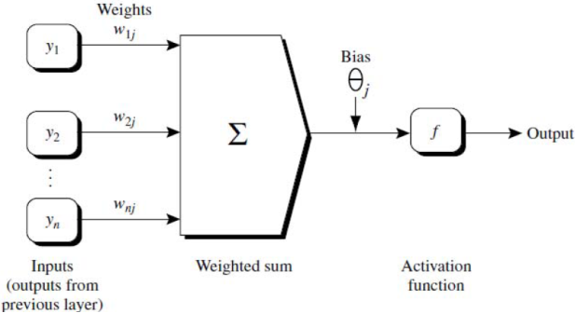
Sl no. | Paper Title | Journal published | Author | Problem Addressed | Author approaches/method | Result
3 | Housing Price Prediction Using Machine Learning Algorithms: The Case of Melbourne City, Australia | 2018 | Dahn Phan | This paper focuses on predicting the price of a house given a set of its characteristics. | Linear Regression: Polynomial Regression: One variable: Multiple variable: Neural Network: | By applying these techniques, we can predict the price of the house.
7

Slide 8



Sl no | Paper Title | Journal published | Author | Problem addressed | Author approaches/method | Result
4. | House Price Prediction Using Machine Learning And Neural Networks | 2018 | Ayush Varma Abhijit Sarma Sagar Doshi Rohini Nair | This paper focuses on predicting the prices of the houses by using the combination of various techniques to increase the accuracy. | Linear Regression: Relationship between dependent and independent variable. Y=w*x+c Forest Regression: Boosted Regression: No of weaker prediction models seeks an approximation F(x) in the form of a weighted sum of hi(x) from class H called weak learners. Neural Networks | This paper predicts the prices of the houses more accurately by using a combination of these techniques.
8

Slide 9
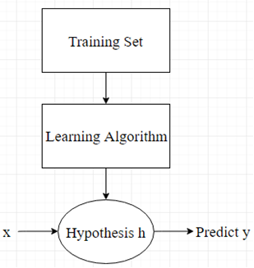
METHODOLOGY
Representation of the Model

Slide 10



METHODOLOGY
Hypothesis:
Parameters:
Cost Function:
It is known as Squared Error Function.
Accuracy of hypothesis is measured by the cost function.
Our goal is to minimize the cost function.

Slide 11
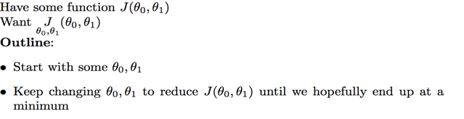
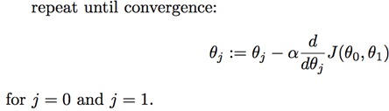
METHODOLOGY
Gradient Descent Algorithm:
We can represent this algorithm as:

Slide 12
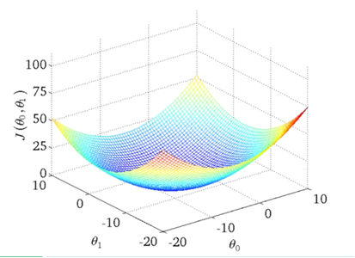
METHODOLOGY
How Gradient Descent Algorithm will minimize Cost Function?
It has only local optimum which will be the global optimum.
We are running gradient descent algorithm, choosing the parameters of cost function, moving step-by-step in the cost function and corresponding to that, our line plotted will also change in the hypothesis function.
When we will reach global optimum, we’ll get a line in the hypothesis function which will fit the data well.

Slide 13
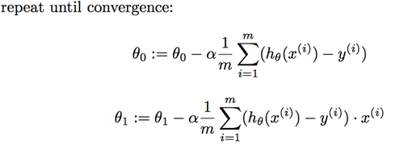
METHODOLOGY
On combining cost function with gradient descent and applying a bit of calculus, we have:
We can use these formulas to solve the problem of linear regression.
13

Slide 14
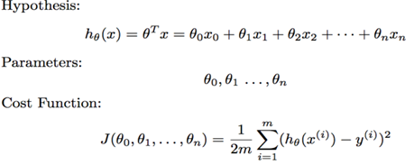

METHODOLOGY
For multiple features of the house, we have modified formulas:
Where:
14

Slide 15
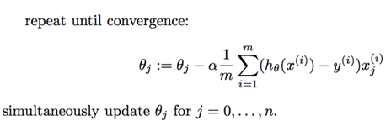
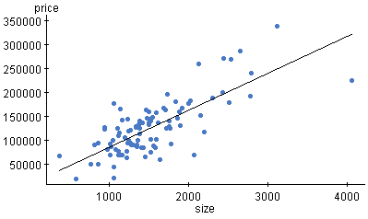
METHODOLOGY
Gradient Descent Algorithm:
We will obtain a plot:
15

Slide 16
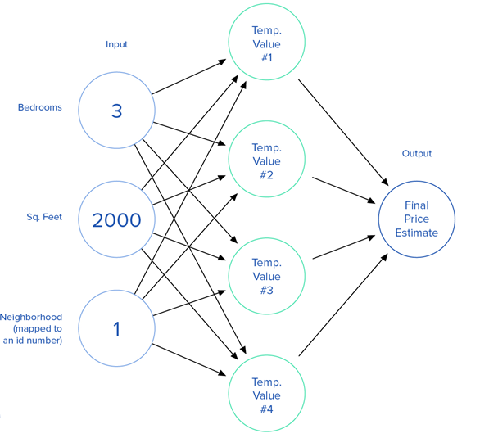
METHODOLOGY
Neural Network:

Slide 17
RESULTS
Consider an example:
Training Set: Hypothesis:
Ѳ₀ = 0.2 | Ѳ₁ = 0.5 | Ѳ₂ = 0.4 | Ѳ₃=0.2 | Ѳ₄ = -0.3
x₀ | Size (x₁) | No of bedrooms (x₂) | No of floors (x₃) | Age of home (x₄) | Price (y)
1 | 2104 | 5 | 1 | 45 | 1260
1 | 1416 | 3 | 2 | 40 | 932
1 | 1534 | 3 | 2 | 30 | 1000
1 | 852 | 2 | 1 | 36 | 684
1 | 1000 | 2 | 2 | 25 | 642
h_{Ѳ}(x⁰) | Ѳ₀¹x₀¹+ Ѳ₁¹x₁¹+ Ѳ₂¹x₂¹+ Ѳ₃¹x₃¹+ Ѳ₄¹x₄¹ = 1041
h_{Ѳ}(x¹) | Ѳ₀²x₀²+ Ѳ₁²x₁²+ Ѳ₂²x₂²+ Ѳ₃²x₃²+ Ѳ₄²x₄² = 698
h_{Ѳ}(x²) | Ѳ₀³x₀³+ Ѳ₁³x₁³+ Ѳ₂³x₂³+ Ѳ₃³x₃³+ Ѳ₄³x₄³ = 760
h_{Ѳ}(x³) | Ѳ₀⁴x₀⁴+ Ѳ₁⁴x₁⁴+ Ѳ₂⁴x₂⁴+ Ѳ₃⁴x₃⁴+ Ѳ₄⁴x₄⁴ = 427
h_{Ѳ}(x⁴) | Ѳ₀⁵x₀⁵+ Ѳ₁⁵x₁⁵+ Ѳ₂⁵x₂⁵+ Ѳ₃⁵x₃⁵+ Ѳ₄⁵x₄⁵ = 496
Training Set:

Slide 18

RESULTS
Cost Function:
h_{Ѳ}(x⁰) = 1041 | y⁰ = 1260 | (1041-1260)² = 47961
h_{Ѳ}(x¹) = 698 | y¹ = 932 | (698-932)² = 54756
h_{Ѳ}(x²) = 760 | y² = 1000 | (760-1000)² = 57600
h_{Ѳ}(x³) = 427 | y³ = 684 | (427-684)² = 66049
h_{Ѳ}(x⁴) = 496 | y⁴ = 642 | (496-642)² = 21316

Slide 19

RESULTS
Gradient Descent Algorithm:
For Ѳ₁ :
For Ѳ₀ :
Similarly, calculations will be done for other parameters as well. Now if we want to predict the price of the house with: Size = 1400, No of bedrooms = 3, No of floors = 2, Age of Home = 10
Therefore, Price = Ѳ₀ * 1 + Ѳ₁ * 1400 + Ѳ₂ * 3 + Ѳ₃ * 2 + Ѳ₄ *10.
Hence, we have predicted the price of the house.
h_{Ѳ}(x) | y | x₀
1041 | 1260 | 1
698 | 932 | 1
760 | 1000 | 1
427 | 684 | 1
496 | 642 | 1
h_{Ѳ}(x) | y | x₁
1041 | 1260 | 0.5
698 | 932 | 0.5
760 | 1000 | 0.5
427 | 684 | 0.5
496 | 642 | 0.5

Slide 20
APPLICATIONS
Developers
Home Buyers
Property Investors
Tax Accessors
Real Estate Market Participants

Slide 21
CONCLUSION
Predicts the price of the house by using linear regression and gradient descent.
Neural Networks further increase the efficiency of the system.
Prevent customers from the trap of real-estate agents.
Additional features can be added.
Larger cities can be added to the database.
Different UI/UX Technologies can be integrated for better visualization.

